Slide 1

Offshore renminbi bond markets – achievements and challenges
György Barcza, CEO
26 March 2015

Slide 2

The Role of Foreign Currency Debt in Public Debt Management
  The ratio of FX-denominated debt has increased heavily since 2008 because of the IMF/EU loan (peak: 51%) – significant FX-risk
  After 2010 major increase in households’ savings: reducing the FX-denominated debt ratio is an important objective
  FX issuance only in order to diversify the investor base (P€MÁK, Residency Bond, new markets)

Slide 3
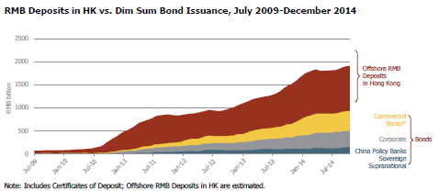
The Development of the RMB-Market
Market volume RMB 1900 billion RMB – rapid development
    From which Bonds: ~ RMB 900 billion
    From which Government Securities and quasi-sovereign: ~ RMB 130-140 billion
  Volume of primary auctions
    2013: RMB 402 billion
    2014: RMB 587 billion
    2015: RMB 480-500 billion
    (Standard Chartered forecast)
Source: FTSE-BoCHK (HongKong) – Offshore RMB Bond Quarterly Research Report, 2015 Q1

Slide 4
The RMB-Market – Examples of Sovereign Issuances
  United Kingdom (14 October 2014)
    RMB 3 Billion (~420 m EUR), 2,7% yield, 3-year-maturity
    Syndicated auction, Stock Exchange listing: London
    Total Bid: RMB 5,8 billion
    85 different investors:
      Asia (56%), US (8%), others (36%)
      Private and public banks (64%), central banks and other public institutions (17%), investment funds and others (19%)
    Purpose: Diversifying and financing a minor part of the official FX-reserves of BoE
  CADES, Frech Social Debt Fund (28 January 2015)
    3 Billion RMB, 3,8% yield, 2-year-maturity
    Syndicated auction, Stock Exchange listing: Paris
    Total Bid : 4,6 billion RMB
    39 different investors :
      Asia (42%), UK (24%), misc. EU (17%)
      Private and public banks (66%), central banks and other public institutions (24%), investment funds and others (10%)
    Purpose: Immediate swap to euro, general financing

Slide 5
The Practice and Goals of International FX Issuances
  Normal practice of AKK
        Longer maturities 5 – 10 years
        Size EUR/USD benchmark-size, Appearance in alternative markets
        Purpose General financing – Refinancing FX-redemptions
        Immediate euro-swap (in compliance with the benchmark)
  Opportunities in the RMB-market
    Shorter maturities Mainly 1 – 3 years
    Size RMB 0,5-1,0 billion
    Purpose General financing or Official FX-reserves financing
  With or without euro-swap

Slide 6
Summary
  The offshore RMB-market has experienced a constant and intensive expansion during the last couple of years.
  The offshore RMB bond market has also developed dynamically – besides corporate bond and Chinese sovereign bond issuances there have been some sovereign bond issuances from the developed countries as well
  Issuance in the offshore RMB sovereign bond market could enable Hungary to further diversify its external borrowing sources.
  No CEE-countries have applied yet – seize first-mover advantage
  We are constantly examining the RMB (sovereign) bond market.
  Issuing in the offshore RMB bond market could satisfy the goals of the broadly defined state (NBH and ÁKK) all at once.

Slide 7

Thank you for your attention!

